Slide 1
Nationalist Revolutions Sweep the West
1789-1900

Slide 2
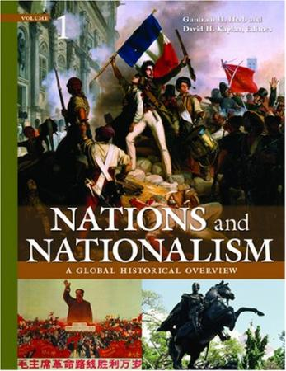
Rising Nationalism
Nationalism was the most powerful
ideal of the late 1700s/ early 1800s.
Increasing numbers of peoples
desired self-government and control
over their own lives.
Inspired by Enlightenment ideals
and by the American and French
Revolutions.
Latin Americans were the first to rise
up against their imperial masters.
Revolutions also erupted within some
European countries 1815-1848.

Slide 3
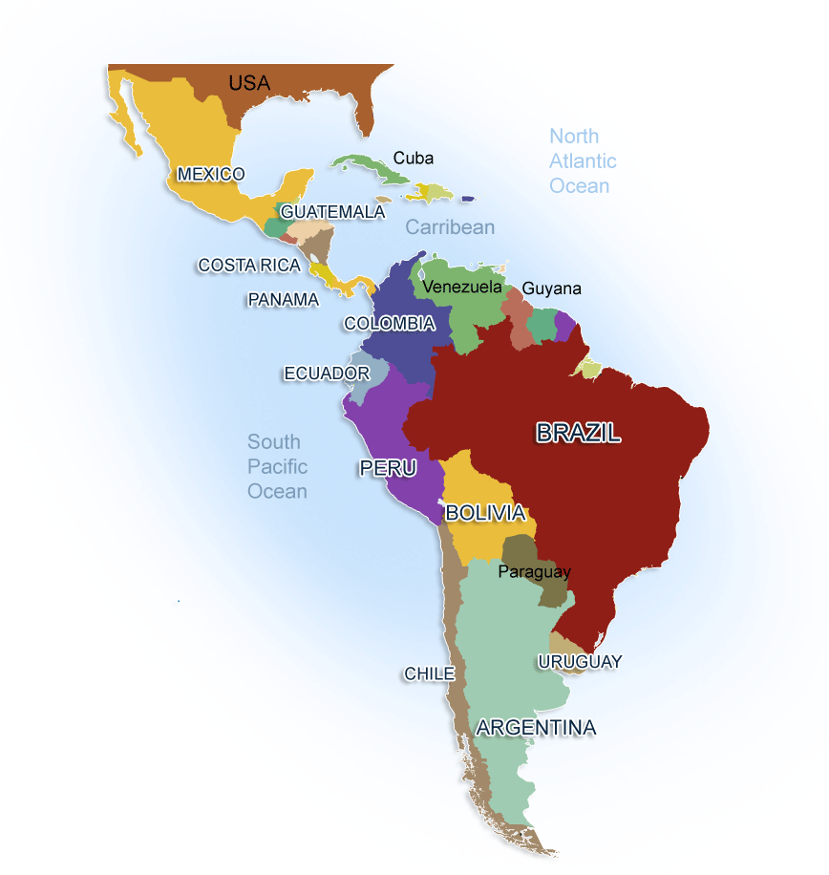
Current day
Latin/South America
E.
I.
H.
G.
J.
F.
A.
B.
C.
D.

Slide 4
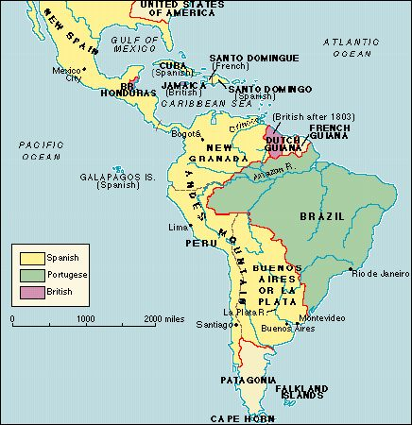
Latin America
in 1800

Slide 5
Early 1800s: Latin America Revolts!
People throughout Latin America inspired by the
ENLIGHTENMENT ideals & FRENCH Revolution.
Latin Americans rose up
against the EUROPEAN/COLONIAL powers that controlled them with the goal of \winning their
INDEPENDENCE.

Slide 6
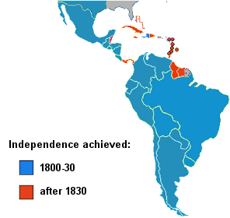

Slide 7
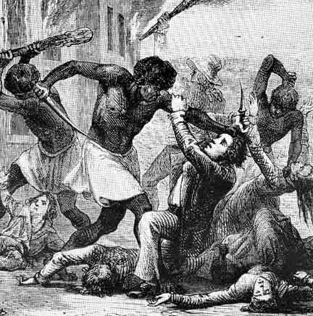
Latin America’s First Revolution, 1791
St. Dominque (Hait)
WHY???
Whites, a small minority, used brutal methods of control.
African slaves outnumbered whites, yet slaves had no political power.
Inspired by enlightened ideas of liberty and equality

Slide 8
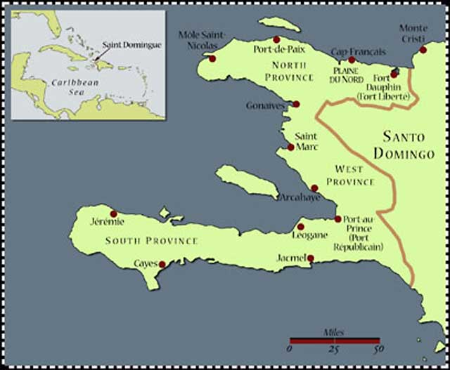

Slide 9
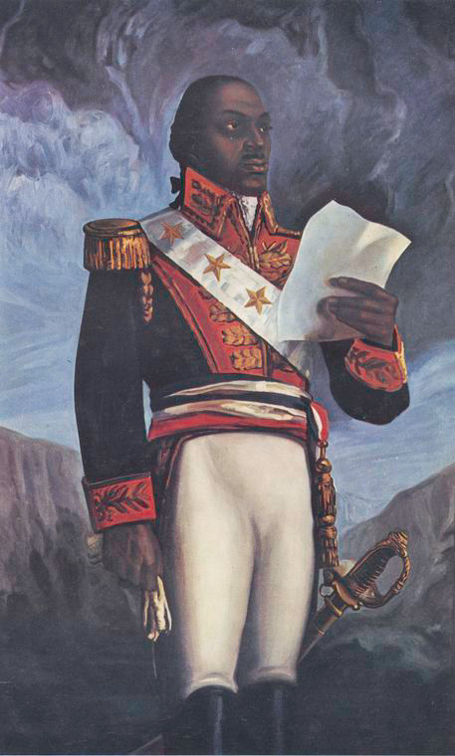
Leaders of Haiti’s Slave Rebellion
Toussanint L’Ouverture
(too SAN loo vair TOOR)
Jean-Jacques Dessalines
Ex-slave
Agreed to end revolution if French ended slavery.
Captured by French and died in French prison.
Victorious general
Won Haiti’s independence.
Haiti’s founding
father
Toussanint L’Ouverture

Slide 10
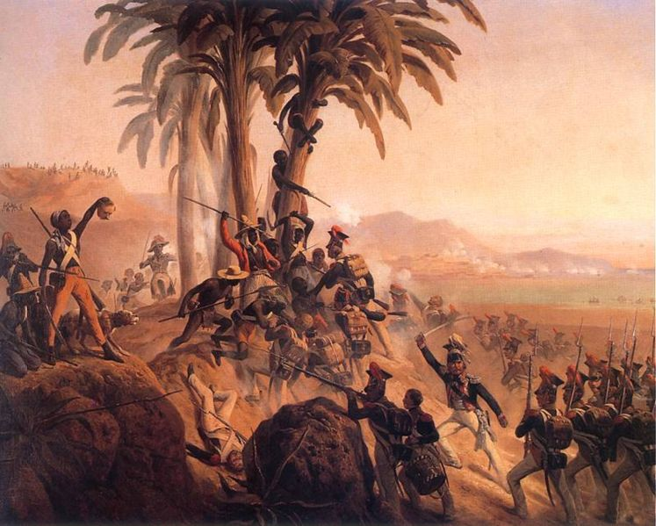
French Fail to Suppress Rebellion
16,000 French troops sent by Napoleon failed to put down.
Ended Napoleon’s plans Expand French empire in the Americas

Slide 11
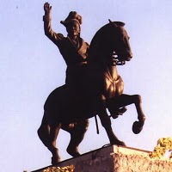
Independence for Haiti
St. Dominque became first Latin American (and first black) colony to free itself from European control.
Became independent state of Haiti 1804.
Haiti’s Founding Father
Jean-Jacques Dessalines

Slide 12
Social Classes in S. America
Social Classes were determined by birth, and there was no opportunity for change. Social Class Groups in the new world:
The Peninsulares- Born in Europe, moved to new world. Highest group. .1%. Only group eligible to hold public office.
The Creoles- born in the new world to European parents. 22.8% of population. Frustrated with lack of opportunity because of birth status.
The Metizos- Mixed European and Indian Ancestry. 7%
The Mulattos- Mixed European and African. 7%
Africans and Indians- though large groups (especially Indians @ 55%) they had very little say and were treated poorly.

Slide 13
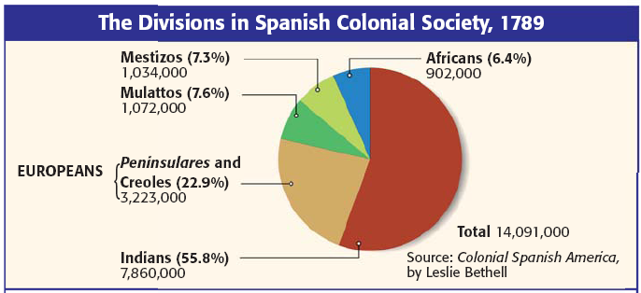
Which groups were European (Spanish)? What was the difference between those two groups?
Which group was at the top of the social pyramid and held all the power?
What was the difference between the Mestizos and the Mulattos?
Which group was comprised of slaves with monetary value?
Which group was at the bottom of the social pyramid?
Which group led most of the revolutions that occurred in Latin America at this time?

Slide 14
Spanish South America’s
Social System
Peninsulares
Creoles
Mestizos
Mulattos
Africans
Native Americans (Indians)
56% of population
Little $$ value
Treated the worst of all classes

Slide 15
Creole-Led Revolutions
Well-educated Creole class led the fight for independence in Latin America. Why?
Wealthy young Creoles traveled to Europe & were influenced by Enlightenment ideas.
Felt mistreated & oppressed by Spain.
Felt no loyalty to a foreign king: Napoleon’s brother, Joseph, whom Napoleon had placed on the throne in Spain.
Peninsular Wars in Europe gave the Creoles an opportunity to gain independence from Spain.

Slide 16
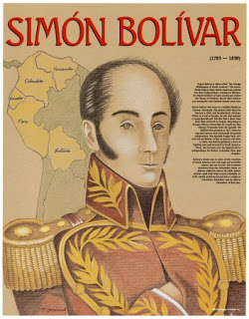
The Libertadores (“Liberators”) End Spanish Rule in South America
Gen. Simon Bolivar (wealthy creole) defeated Spanish army and won independence for Venezuela in 1821.
Gen. Jose de San Martin won independence for Argentina & Chile
Bolivar then defeated Spanish in Peru,
winning freedom for all Spanish colonies in Latin America in 1824

Slide 17
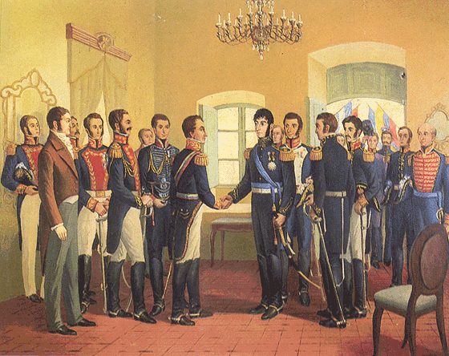
Meeting between Bolivar and San Martin in Ecuador, 1821

Slide 18
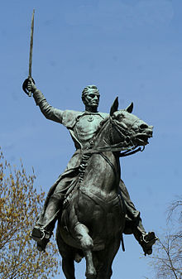
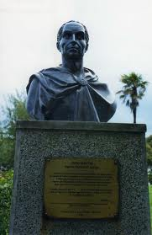
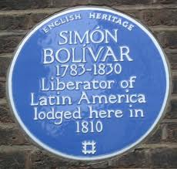
The George Washington of Latin America Simon Bolivar

Slide 19
Revolution in Mexico
1810-1821

Slide 20
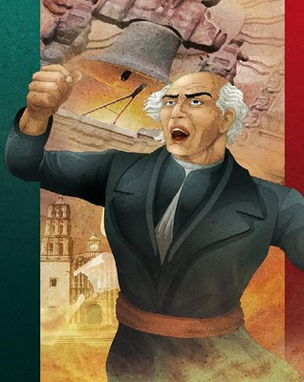
Mexico ends Spanish rule
Village Priest, Padre Miguel Hidalgo, (mee-GEHL ee-THAHL- goh) rang his church bells and called for “Death to all Spainards
Raised an army and killed many Spaniards before being caught and executed by firing squad.

Slide 21
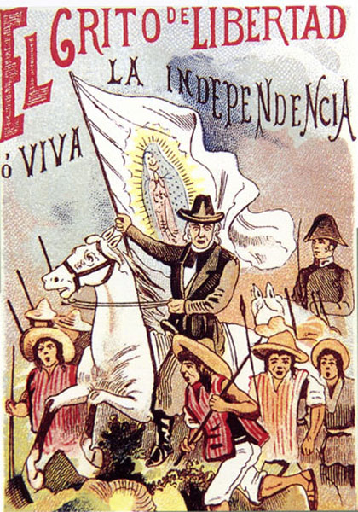
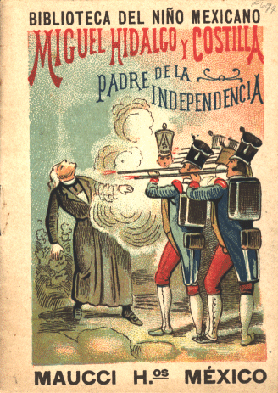
Miguel Hidalgo Leads Mexican Revolution

Slide 22
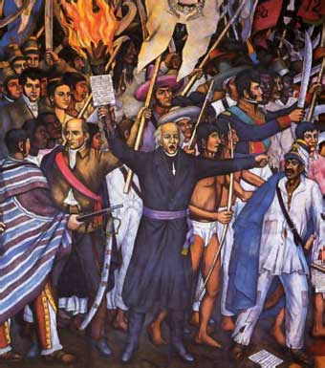
Revolution in Mexico, 1810-1821
Mexican revolution was led by Indians and Mestizos
Mexico’s Creoles joined the fight later .
Mexico won its independence from Spain in 1821.
Padre Miguel Hidalgo

Slide 23
Revolution in Brazil
1822

Slide 24
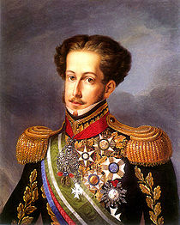
Revolution in Brazil, 1822
Creoles demanded independence
from Portugal in 1822.
Petitioned king’s son Dom Pedro, to rule them, and after agreeing, he declared Brazil’s independence.
What was unique about Brazil’s
revolution?
No fighting. Bloodless revolution.
Brazil’s Royal Liberator
Dom Pedro

Slide 25
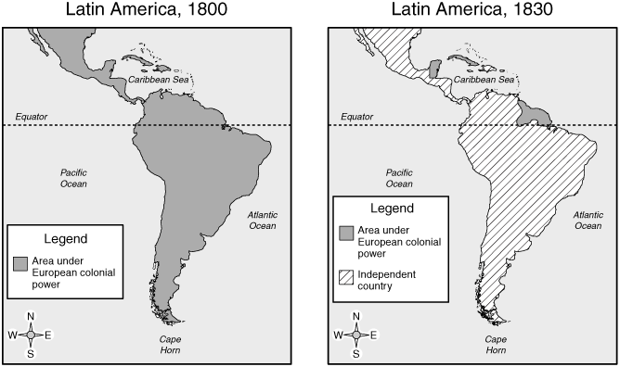
Latin American Independence, 1830

Slide 26
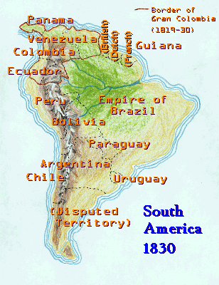
Independence Brings Disunity
Destruction caused by the wars for independence left Latin America poorer and divided.
The dream of some for a united Latin America quickly fell apart.

Slide 27
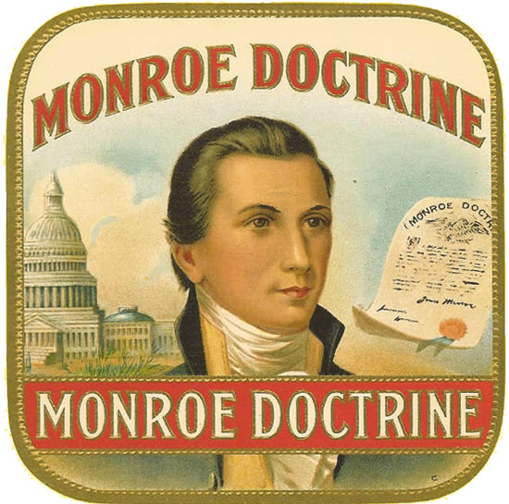
The Monroe Doctrine, 1823
U.S. warns European
nations to stay out of the
Western Hemisphere.
U.S. regional influence
grows.
The U.S. becomes the
dominant power (the
hegemon) throughout
Latin America.

Slide 28
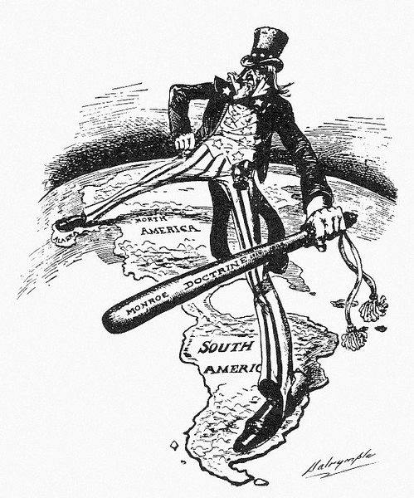
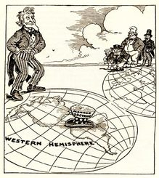
The Monroe Doctrine

